Slide 1


Presentation on
Click 2 Wizard
Team Id : 12111 Group Id : 13
Enrollment No. : 110020107029
110020107003
Name: Tikekar Chintan R.
Kathiriya Kishan V.
Ahmedabad Institute of Technology Gujarat Technological University

Slide 2
Outline
Introduction
Project Profile
Objectives
Tools & Technology
Modules in Project
System Flow(Context Diagram)
Data Flow Diagram
Use case Diagram
Activity Diagram
Sequence Diagram
Features
Expected outcome
Advantages
Limitations
Future work
References

Slide 3
Introduction
Here we are introducing a website that provides dynamic database system which can be access from anywhere using internet.
Through Registration any user or company can access this website and can make his own database in few steps.

Slide 4
Project Profile
Title | Click 2 Wizard
Project Description | Dynamic database portal
Portability | Everywhere through internet
Internal Guide | KAVITA PANDYA
Objectives | Making online database system
Project category | Java / Hibernate
Timeframe | 2/7/’14 to 14/2/’15
Software | Eclipse Luna Windows 7 Apache tomcat server Mysql Database
Hardware | Intel i3 processor 2 GB Ram 320 GB HDD

Slide 5
Objectives
Remove the code for writing queries, minimize the technical things and provides accessibility of the database anywhere.

Slide 6
Tools and Technology
Development Architecture : MVC
Language Technology : Java J2EE,JSTL
Framework : Hibernate
Server : Apache Tomcat 7
Web Technologies : HTML5,CSS3, JQuery, JS
Database : MySQL
Database Server : WAMP Server
Tools to be used : Eclipse Luna (4.4.0)

Slide 7
Methodology(Modules)
Admin | Clients
Manage Server for the website | Sign up / Login
Manage Clients | Manage profile
Manage Requirements | Create and manage Projects
Manage Packages | Create and manage tables
Maintenance | Import or Export tables
Payment tracking | PayPal Payment
Manage complaints | Select Package for accessing website

Slide 8
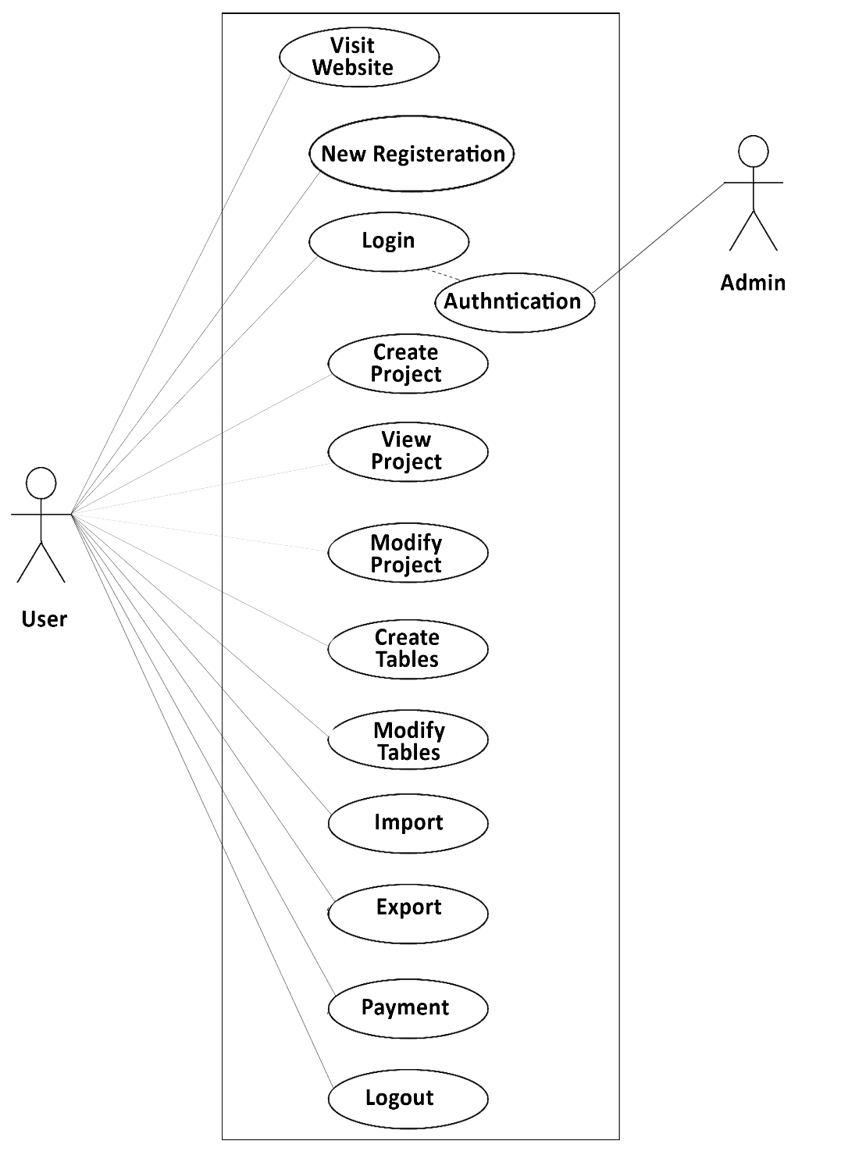
Use case Diagram
Use case Diagram for User

Slide 9
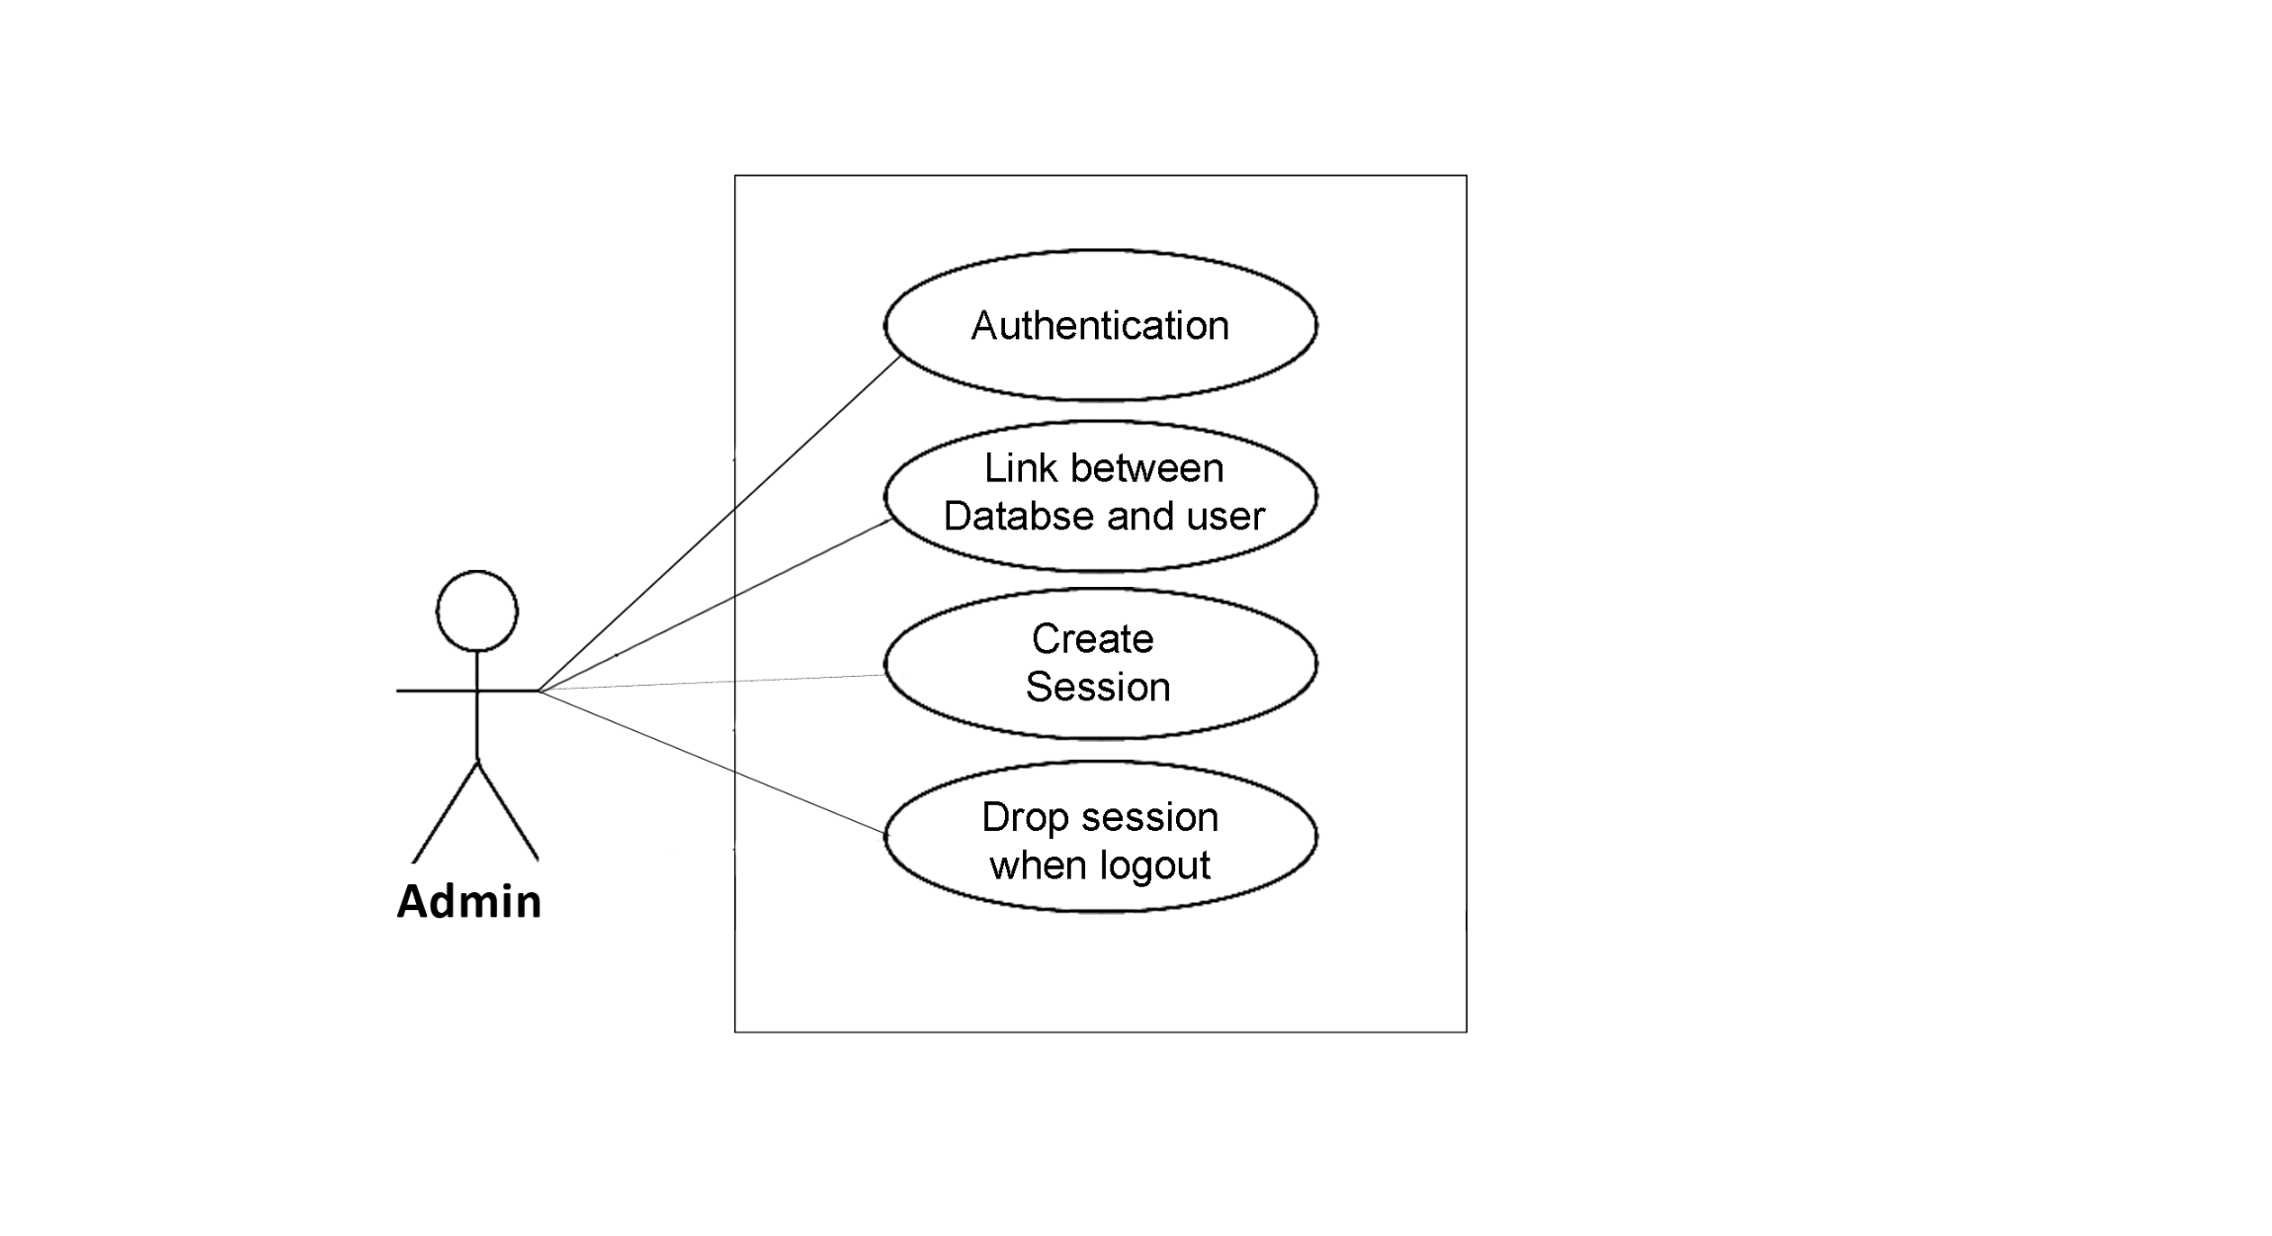
Use case Diagram
Use case Diagram for Admin

Slide 10
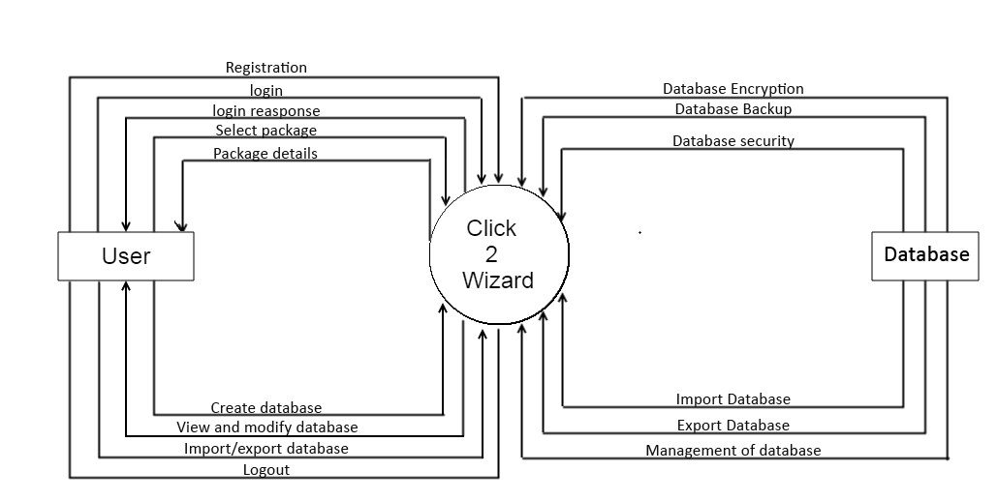
System Flow

Slide 11
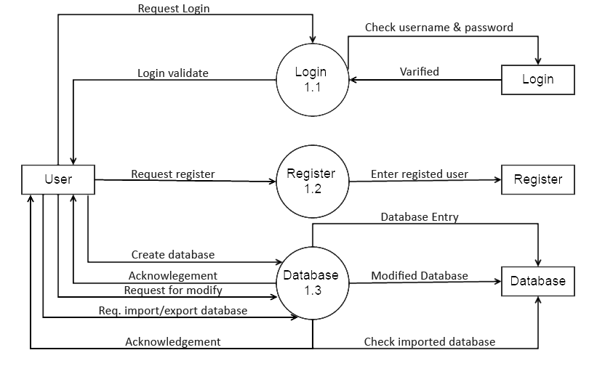
Data Flow

Slide 12
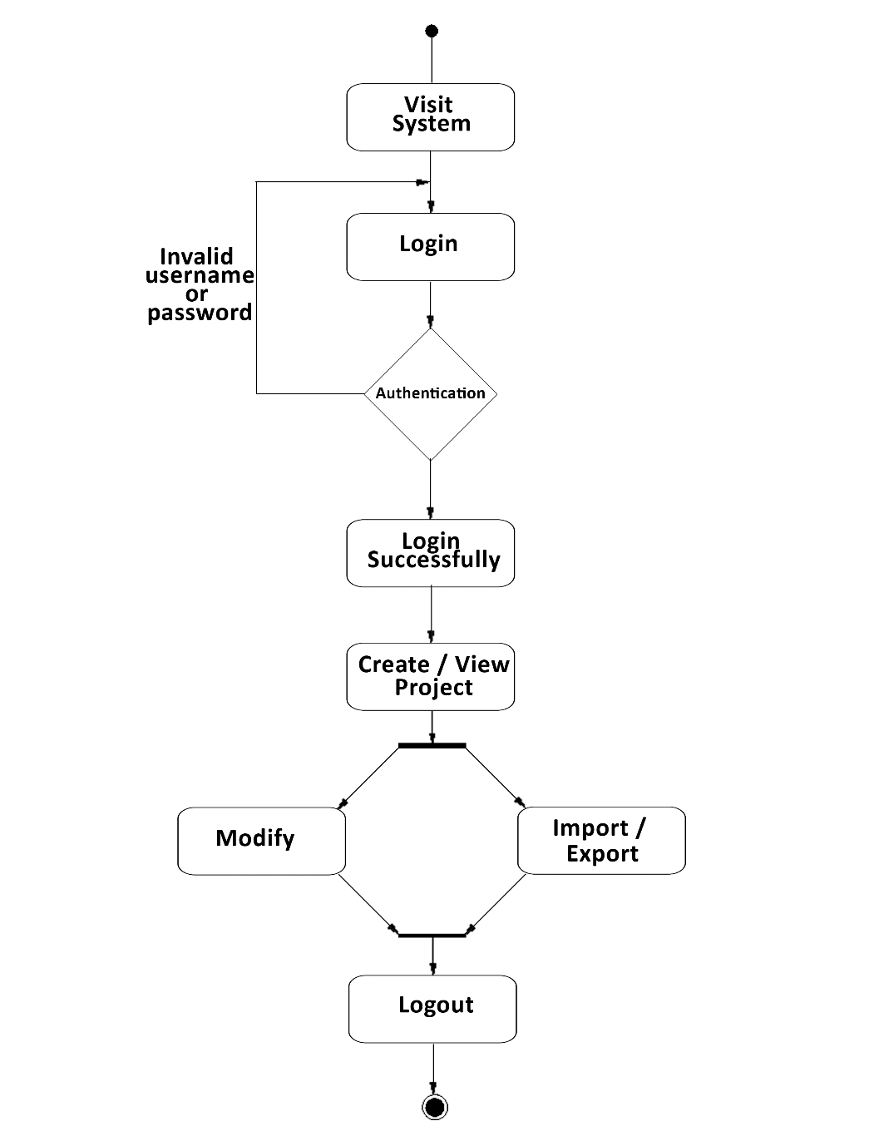
Activity Diagram

Slide 13
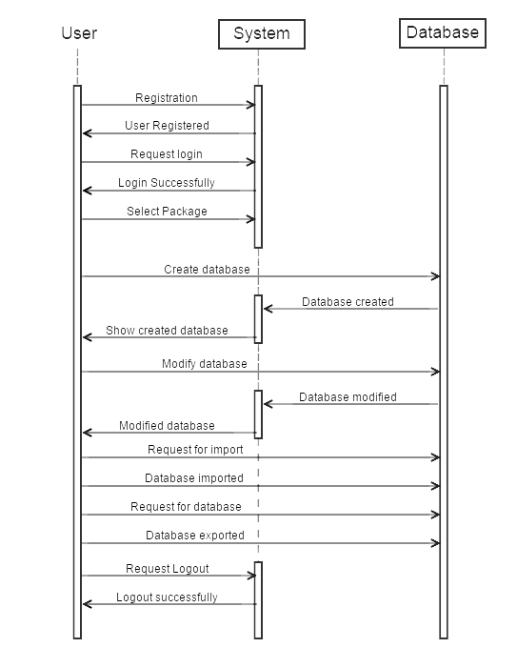
Sequence Diagram

Slide 14
Features
Implementation with Amazon Cloud Services makes the system very Secure in terms of hacking the database
MD5 Algorithms for the login System
Java Based System makes internally processing fast to access the database
Totally Query free
Accessing Database will be much more easier
Easy and Very Simple User Interface.

Slide 15
Expected outcomes
Analysing the future aspects we can conclude that this website is going to give efficient & more effective results in comparison of current applications, because it allows you to make the Database whatever you wants and gives the accessibility of that Database instantly whenever you needed.

Slide 16
Advantage
Providing a simple and Effective UI makes the user understand clearly about the website and can make his own Database in Few Steps.
User need not worry about the Queries like accessing the Database or updating.
No need of any software or server configuration just log in the website, your database will be there.
Provides Relationship among tables
Facility like Importing and Exporting of tables will be there.

Slide 17
Disadvantage
User May worry about Server response problem(Server Down).

Slide 18
Future Work
Building the System Linux based
Efficiency
Load Balancing
Response Time
Fault Tolerance/Error Reporting if any
Looking forward for an ANDROID APPLICATION for such a project.

Slide 19
References
Caspio.com
Trackvia.com

Slide 20
Thank You

